Slide 1

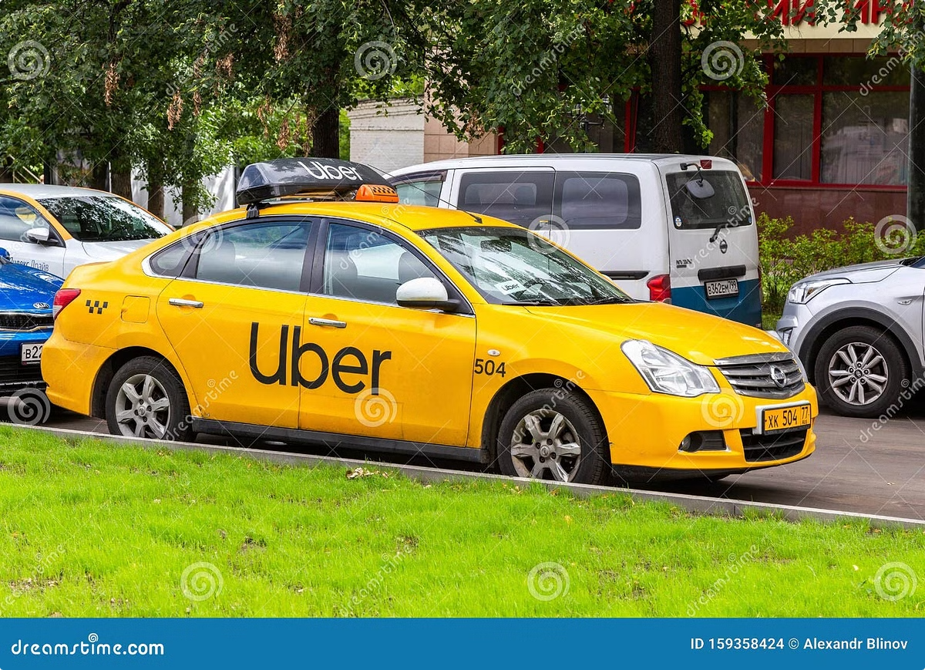

Dynamic Pricing Strategy for Uber
Dynamic pricing is a data-driven approach to fare optimization that empowers Uber to deliver better business outcomes. By leveraging real-time market insights, Uber can adapt pricing to meet ever-changing demand and driver availability, leading to a win-win scenario for both riders and drivers. This presentation will explore the why, how, and benefits of dynamic pricing, ultimately demonstrating its value to Uber's success.
by Praveen Yarramalla

Slide 2

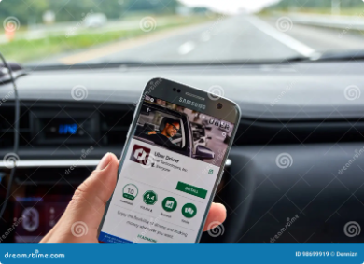
The Need for Dynamic Pricing
1
Current Fares
2
Demand Fluctuation
Uber's current system only considers ride duration, which doesn't account for fluctuating market conditions.
Demand and driver availability change throughout the day, affecting customer experience and profitability.
3
Real-Time Adjustment
4
Fair Pricing
A dynamic pricing strategy ensures fares adjust based on real-time conditions, optimizing revenue and customer satisfaction.
A dynamic pricing model ensures Uber can adjust fares based on real-time conditions, optimizing revenue and customer satisfaction.

Slide 3
How Dynamic Pricing Works
Current Situation
Dynamic Pricing Approach
Benefits
Uber uses a fixed fare system based solely on ride duration, resulting in inconsistent pricing for riders and drivers.
This approach aligns prices with market demand, ensures riders pay fair prices, and helps drivers earn more during peak hours.
A dynamic pricing approach leverages real-time data to adjust fares based on demand, driver availability, time of day, and other relevant factors.

Slide 4


Key Data Points Considered
Number of Riders
Number of Drivers
Location and Time
Type of Ride
Customer Loyalty
Ride Duration
Historical Prices
Weather Conditions
Special Events

Slide 5


Benefits of Dynamic Pricing
Riders
Fair pricing, especially during low-demand times, and the ability to choose based on urgency.
Drivers
Higher earnings during peak hours and greater flexibility, allowing them to adjust their work schedule based on demand.
Uber
Improved revenue, optimized pricing based on real-time market conditions, and better customer retention through fairer pricing.

Slide 6





Real-World Impact
Increased Profitability
Dynamic pricing helps Uber maximize revenue by adjusting fares based on real-time market needs.
Case Example
When demand outstrips supply, such as during rush hour, prices increase to ensure availability for those who need rides most.
Improved Customer Satisfaction
Riders benefit from fairer pricing, especially during low-demand times, while drivers earn more during peak hours.

Slide 7


Implementation Process
1
Phase 1: Data Analysis
Analyze historical ride data to identify trends and patterns in demand, driver availability, and pricing.
2
Phase 2: Model Development
Develop a dynamic pricing model that utilizes real-time data to calculate optimal fares based on market conditions.
3
Phase 3: Pilot Implementation
Roll out the dynamic pricing model in a pilot city to measure its impact on revenue, customer satisfaction, and driver earnings.

Slide 8


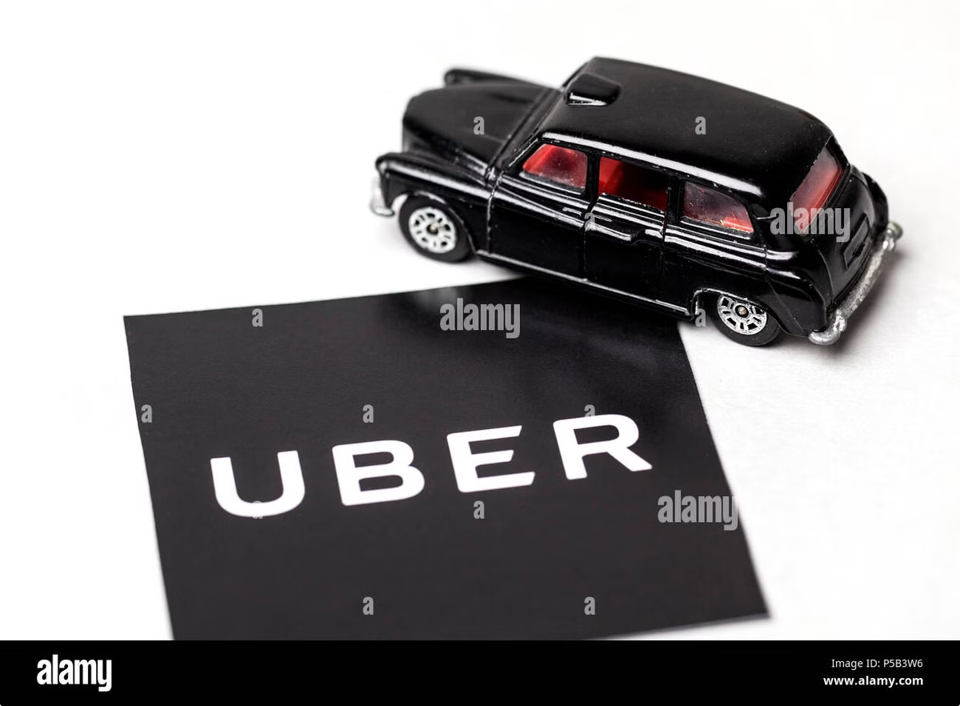


The Road Ahead
Data-Driven Optimization
Continuously monitor and analyze data to refine the dynamic pricing model and ensure it delivers optimal results.
Expansion to Other Cities
Expand the implementation of dynamic pricing to other cities based on the pilot program's success and the specific needs of each market.
Customer Engagement
Communicate the benefits of dynamic pricing to riders and drivers, fostering understanding and building trust in the new system.

